Slide 1
Data Analysis Demo

Slide 2
What is Data Analysis?
It is the process of evaluating data in order to get insights and useful information

Slide 3

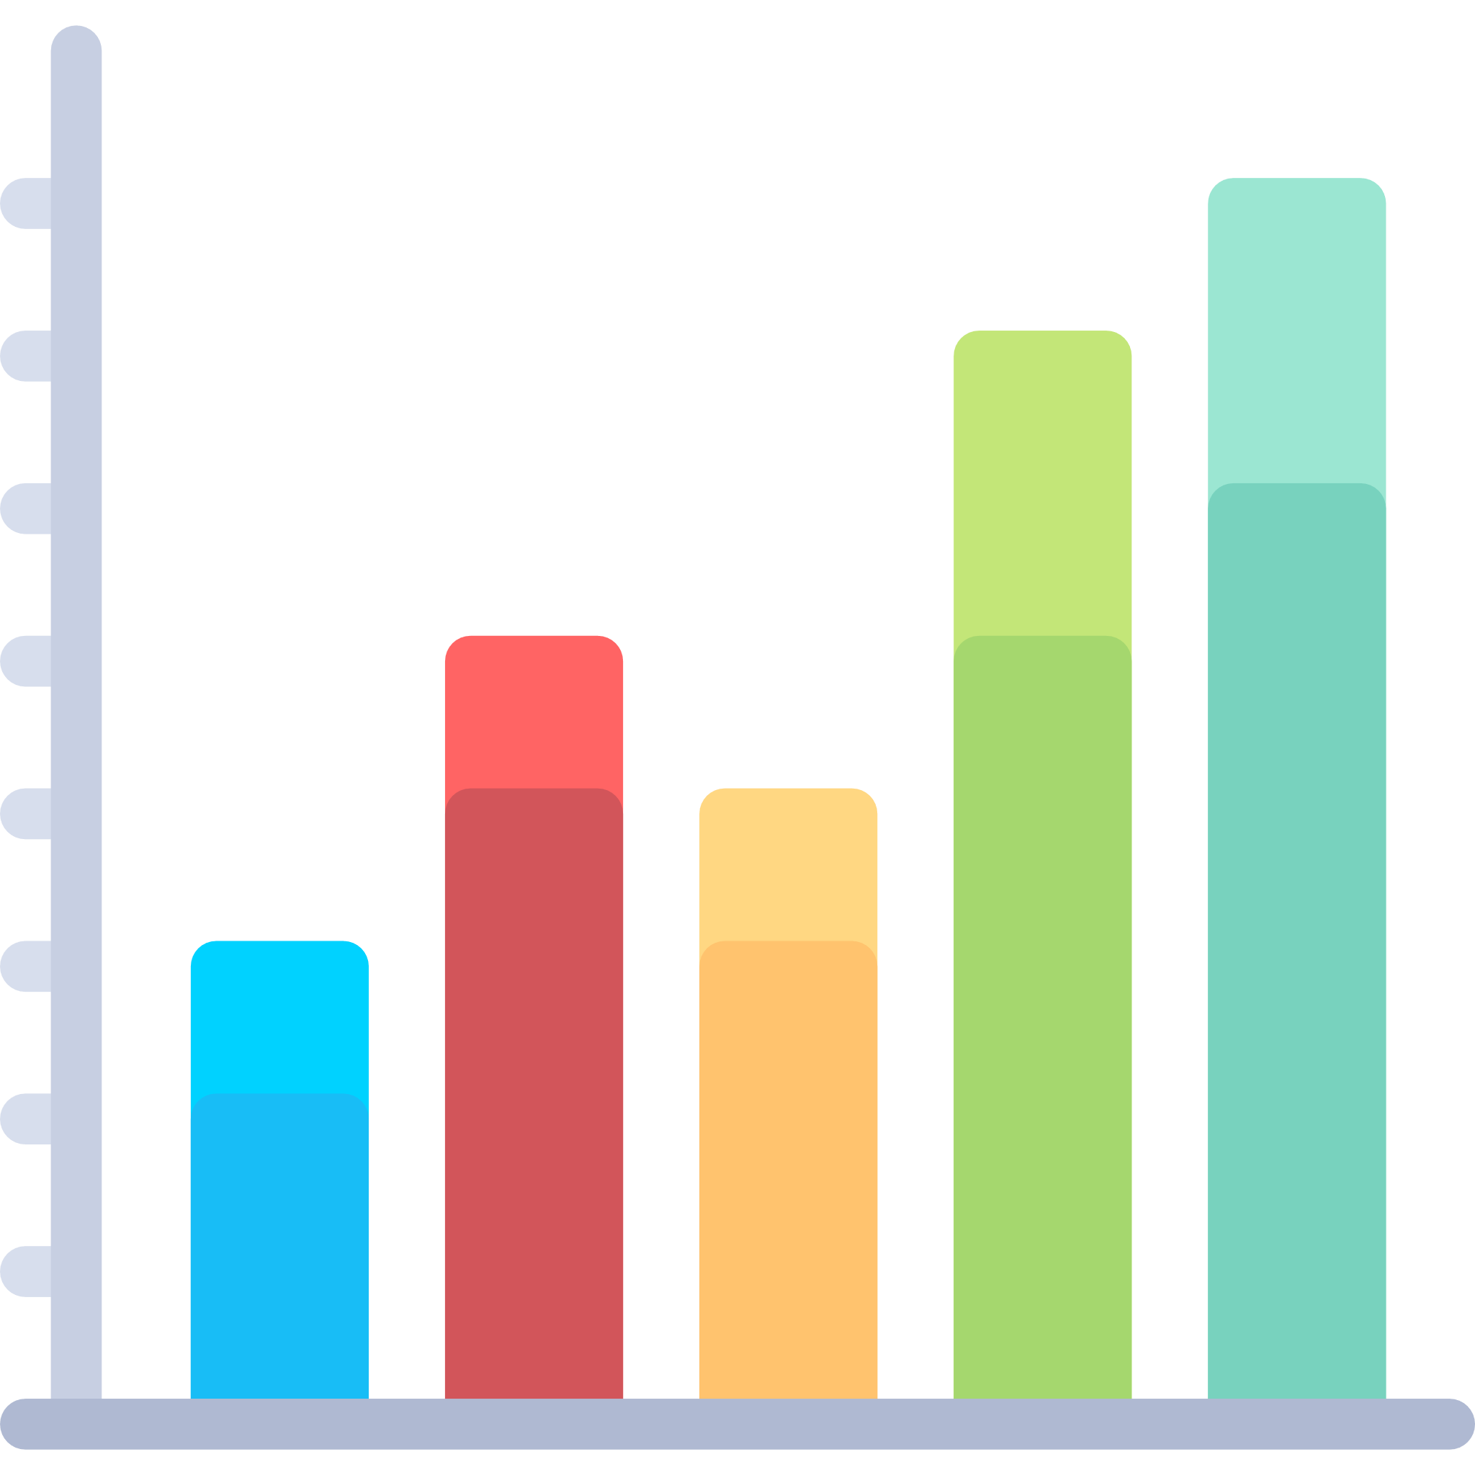
Data Analysis is a combination of 2 major things
Computers
Statistics
Notes:
These are the key foundations of data analysis

Slide 4
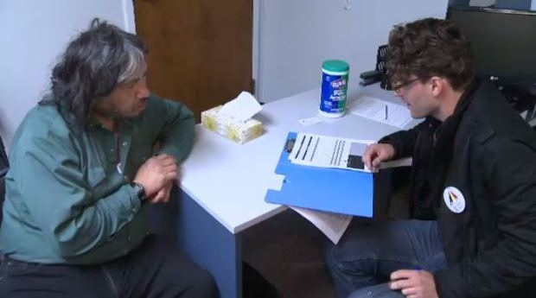
Statistics used to rely on a sample size to represent the majority
Grab someone who has met your criteria.
Ask them your questions.
Pay them a reward.
Get enough people to take the survey (usually around 30 to a 100).
Crunch the numbers and get some insights.

Slide 5
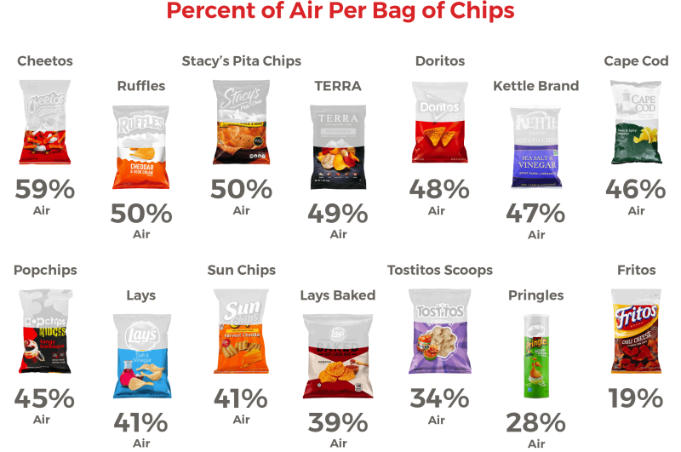

What about in my context?
/r/dataisbeautiful

Slide 6
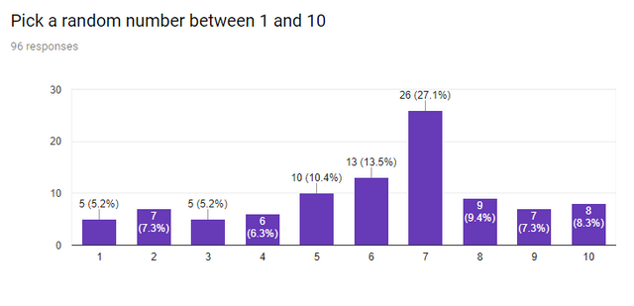
What about in my context?
/r/dataisbeautiful

Slide 7


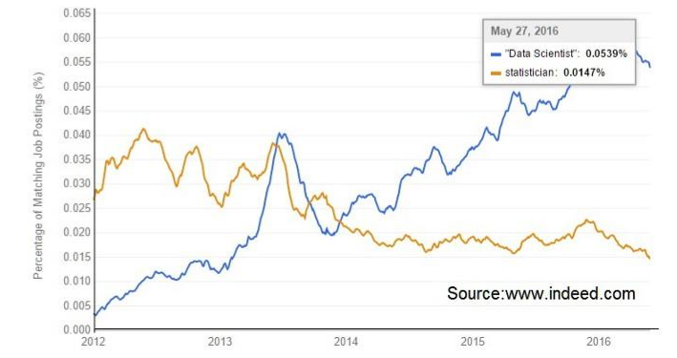









Current state of the Philippines

Slide 8
ACTIVITY: What about in my context?
Map out a graph showing the relationship of…
Sleep
Playing games
Studying time
Grades

Slide 9
Data Science Process

Slide 10
The data science process
Find
Obtain
Scrub
Understand
Model
Interpret
F
Find a problem you’d like to solve
O
Obtain data from relevant sources
S
Clean the data into a format that is machine readable
U
Understand the data you have
M
Create models for forecasting and prediction
I
Get insights and provide recommendations based on the results

Slide 11
Coverage for today
Find
Obtain
Scrub
Understand
Model
Interpret
F
Find a problem you’d like to solve
O
Obtain data from relevant sources
S
Clean the data into a format that is machine readable
U
Understand the data you have
M
Create models for forecasting and prediction
I
Get insights and provide recommendations based on the results

Slide 12



Different sources to get data
Internal Data
(Company/Personal)
Download Online
Web Scraping

Slide 13






Scraping vs Crawling
Page D
Page B
Page E
Page A
Page C
It is the process of extracting data from a website into a structured format for further processing.
Traverses through multiple pages until they fulfill collecting the specific information needed
i.e., getting and downloading the links

Slide 14

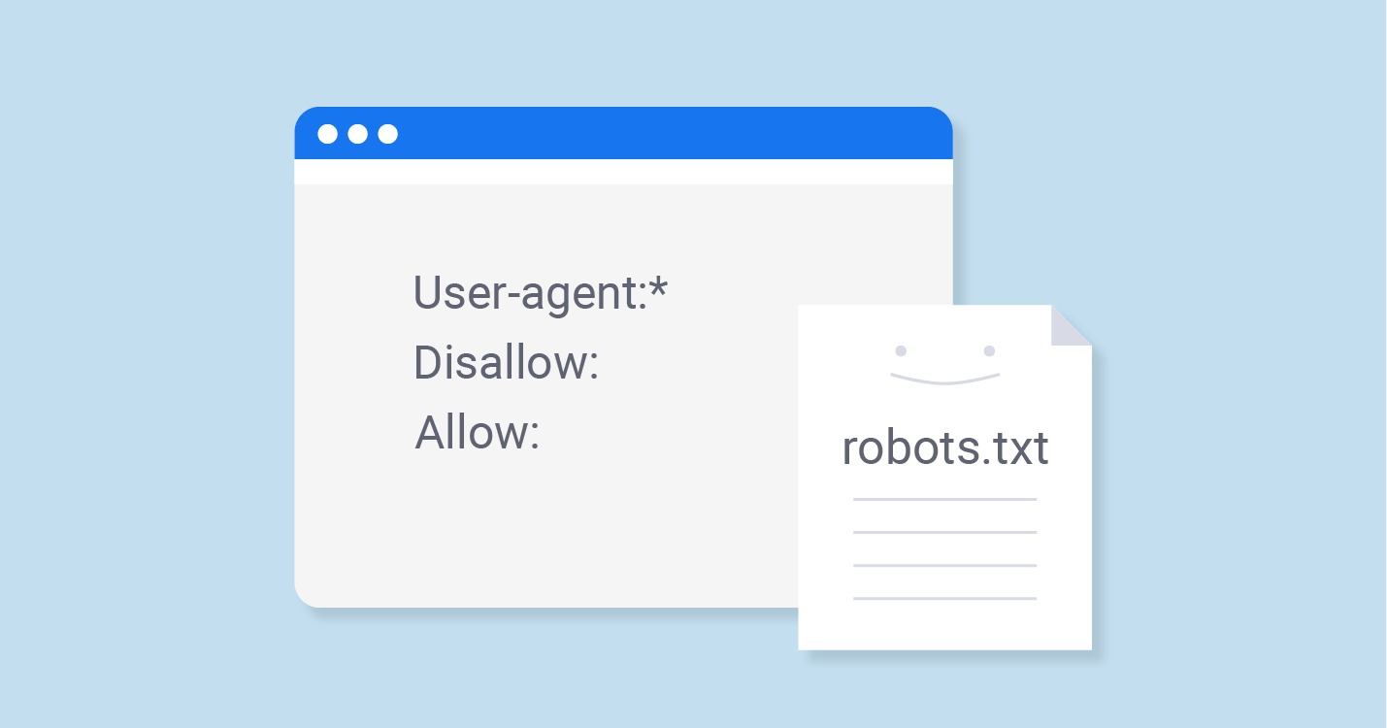

Ethics of web scraping
Terms of Service
robots.txt
Interaction throttling
Notes:
Look at the terms of service. It’s important to check if you can extract information.
Check out robots.txt. Most websites have this and it will tell you which pages you’re not allowed to scrape.
Who here knows what will happen if too many people access a web site?

Slide 15

Important points in getting information
Selenium - a free automated testing suite for web applications across different browsers and platforms.
Xpath (XML Path Language) – use path expressions to select nodes in a web page
Class Name - used to define equal styles for elements with the same class name

Slide 16
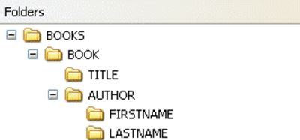
Important points in getting information
Selenium - a free automated testing suite for web applications across different browsers and platforms.
Xpath (XML Path Language) – use path expressions to select nodes in a web page
Class Name - used to define equal styles for elements with the same class name

Slide 17
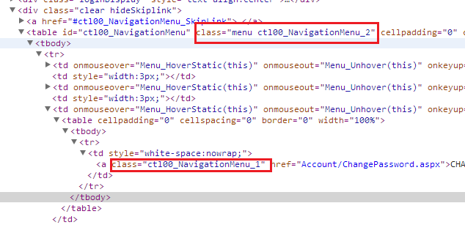
Important points in getting information
Selenium - a free automated testing suite for web applications across different browsers and platforms.
Xpath (XML Path Language) – use path expressions to select nodes in a web page
Class Name - used to define equal styles for elements with the same class name

Slide 18
Today’s Commands
Commands | Description
find_element_by_xpath | Allows you to go to the specific location of an element i.e., address
find_element_by_class_name | Returns the first element with the matching class name
find_elements_by_class_name | Returns all the elements that fall under that class name
find_element_by_tag_name | Locates the information based on its tag name (<div>, <h1>, etc.)

Slide 19
Exercises

Slide 20
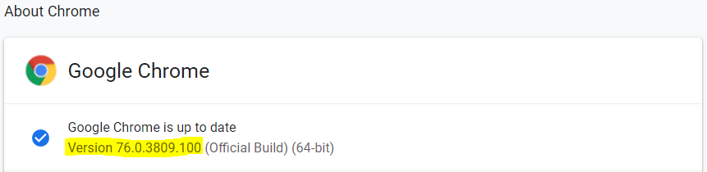
Preparations
Download chromedriver at https://sites.google.com/a/chromium.org/chromedriver/downloads
Make sure your chromedriver matches the version of your Chrome browser

Slide 21
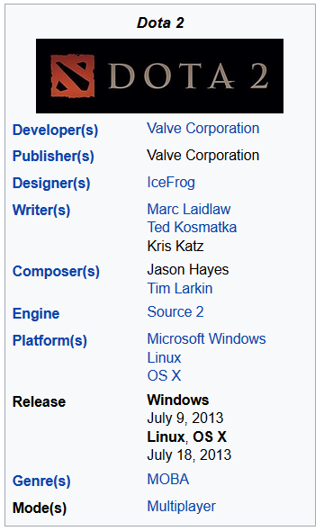
Exercise 1: Scrape a Wikipedia Article
Step 1: Fill out the URL inside browser.get(‘…’)
Step 2: Head over to https://en.wikipedia.org/wiki/Dota_2
Step 3: Get the details from the top right box
BONUS: Save the details into a csv file

Slide 22
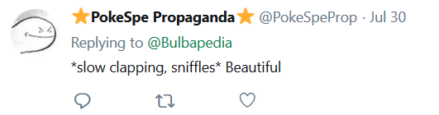
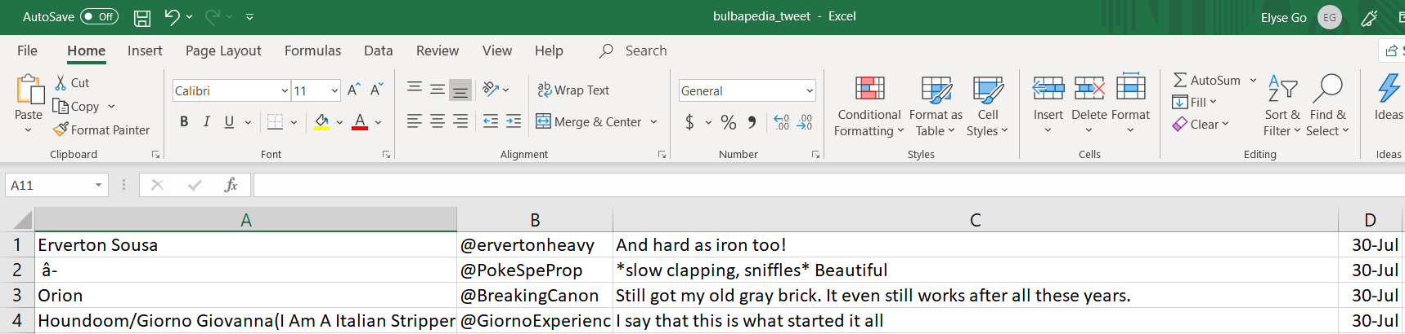
Exercise 2: Scrape Comments from this Tweet
Step 1: Go to this link https://twitter.com/Bulbapedia/status/1156414180393717761
Step 2: Get the username, date, and comment
Step 3: Save it in a csv file

Slide 23
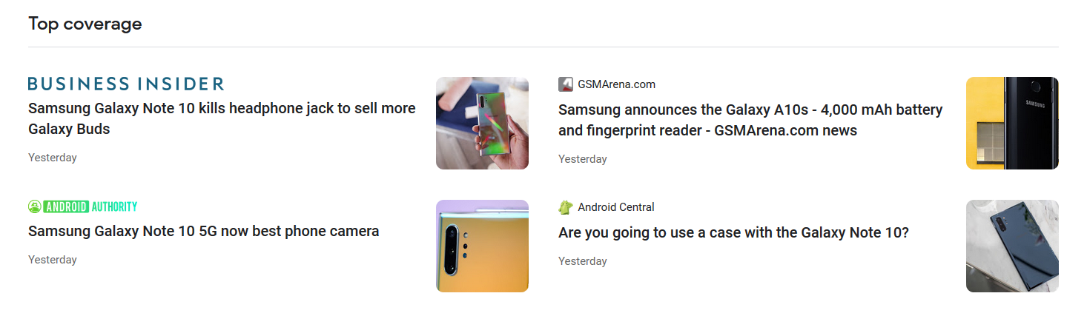
Homework: Scrape Philippine News
Step 1: Go to this specific Google News topic (link)
Step 2: Get the titles and links to the top covering articles
Example below. Articles may differ.

